Slide 1
Assistive Adaptive Technology To The Benefit Of The Education Process
Hosted by ,
Shelby Lundquist
Notes:
Assistive and adaptive technologies defined and linked to the importance of reaching students with disabilities. Providing the rights provided to them and fostering confidence are the pinnacle motives for educators.

Slide 2
Assistive Technology Act of 1998 - Section 508 Congress Finds that disability is a natural part of the human experience and in no way diminishes the rights of individuals.
Notes:
The disabled have the right to -Live independently, enjoy self determination, benefit from education, pursue meaningful careers, enjoy full inclusion and integration in the economic, political, social, cultural, and educational mainstream of society in the United States.

Slide 3
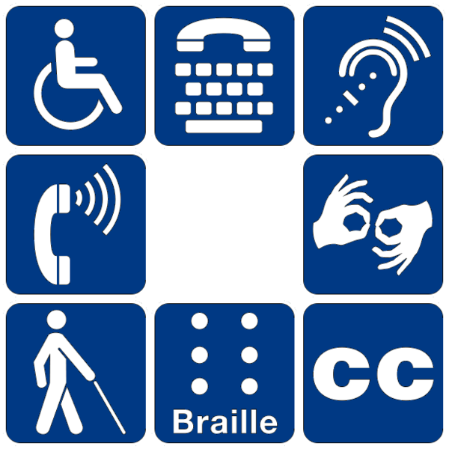
Types of Disabilities
Attention-Deficit/Hyperactivity Disorders
Blindness or Low Vision
Brain Injuries
Deaf/Hard-of-Hearing
Learning Disabilities
Medical Disabilities
Physical Disabilities
Psychiatric Disabilities
Speech and Language Disabilities
Notes:
The multitude of recognized disabilities has grown to include language barriers categorized by the English as a second language students. This long list of disabilities can be grouped more simply as physical, cognitive, and sensory disabilities.

Slide 4
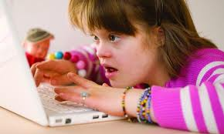
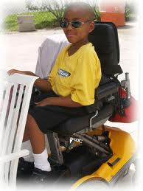
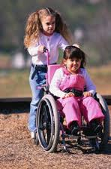
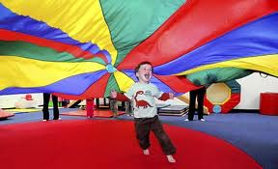

Slide 5
How Can We Reach them ?
Notes:
As educators, what is our role in deciphering challenges, destroying boundaries, and creating the comfort and confidence needed by students with disabilities?

Slide 6
Assistive/Adaptive Technologies
Combined with the fostering of hope and fortitude to succeed
Notes:
The range of available technologies and their advancements are broad to say the least. However, these technologies do not teach independently, nor do they consistently offer encouragement and praise, that honor is bestowed on all of us, the teachers.

Slide 7
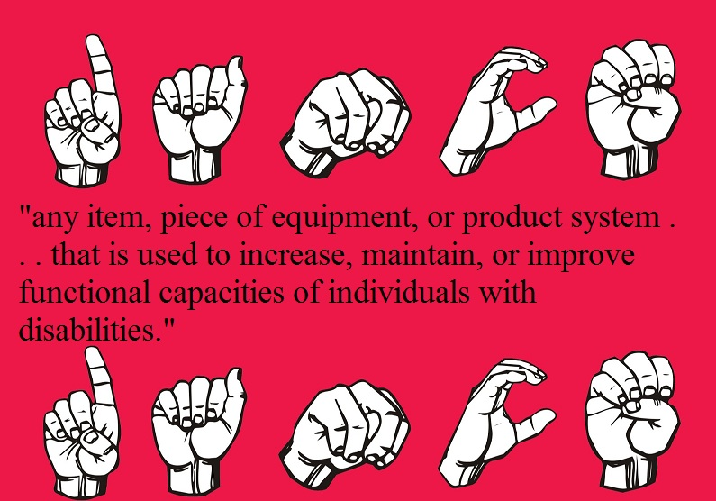
Notes:
The term assistive technology usually brings to mind high-tech devices, but federal legislation defines assistive technology as "any item, piece of equipment, or product system . . . that is used to increase, maintain, or improve functional capacities of individuals with disabilities." Something as simple as a pencil with tape wrapped around it to make it easier to hold for a student who has impaired muscle control in her hands is included in the federal definition of assistive technology.

Slide 8
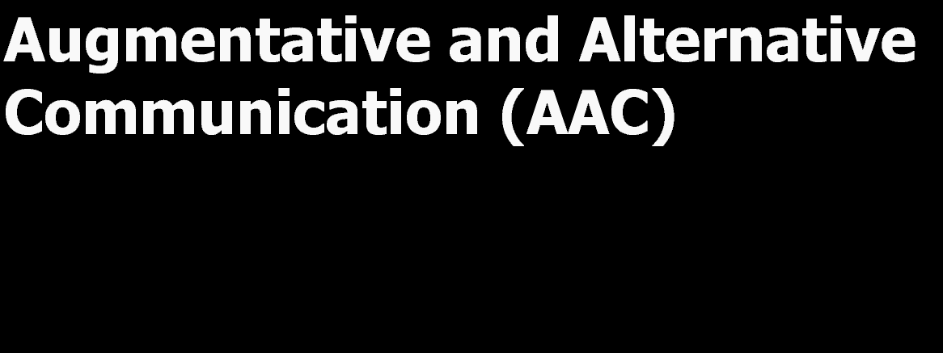
Augmentative communication devices help in producing and understanding speech.
Examples:
-A board with pictures listing student's daily needs &
-electronic speech synthesizers
- Text to speech
Notes:
Augmentative communications are the substitutes for speech or writing.

Slide 9
Adaptive Computer Use
- expanded keyboards
- joysticks in place of a mouse,
- one handed operation keyboards
- blinking and blowing recognition
- braille input and output devices
- text-to-speech software
Notes:
Adaptive technology offers people with disabilities the opportunity not just to use computers, but to use computers to complete tasks that were previously not possible for them. Computers can be used to assist individuals with speech or writing impairments, physical or mobility impairments, visual impairments, and learning disabilities.” (Harrell, 1998)

Slide 10
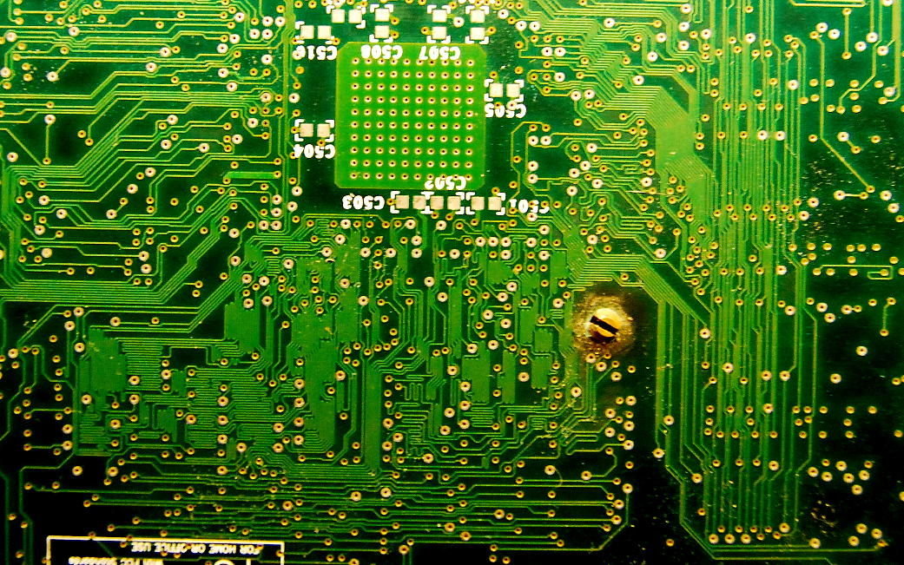
Ensuring Participation
Processing programs
Spell checkers
Word prediction programs
Voice synthesis
Notes:
Computer technology provides answers. Students with inability to write legibly uses word-processing programs, Students with problems spelling -spell checkers, Physically impaired typing-Word prediction programs, Students with reading problems -voice synthesis, Computer technology can provide the multisensory and interactive experience necessary to gain and maintain student engagement. Along with the adaptive design and assistive durability, computer technologies allow for a differentiated experience among students without disabilities.

Slide 11
Resources Receiving Credit
Disability.gov. (2012). Retrieved from https://www.disability.gov/
Empowering rural students with disabilities through assistive technology. (2012).
Retrieved from http://www.sedl.org/rural/seeds/assistivetech/atdefine.html
Harrell, W. (1998). Adaptive computing technology and the disabled..
Litt, S. (2008). Learning disability or language development issue?. Retrieved from http://www.everythingesl.net/inservices/special_education.php
Maresh, J. (2011). Assistive Technology Partnership. Retrieved from
http://www.atp.ne.gov/techassist/def-legal.html
Empowering rural students with disabilities through assistive technology. (2012). Retrieved
from http://www.sedl.org/rural/seeds/assistivetech/atdefine.html
Notes:
Credits

